Slide 1
Big Mountain Resort Ticket Pricing
Gerald Jean Baptiste

Slide 2
What is the problem
Visitors at BMR
each season
BMR added new ski lift to better distribute visitors across the mountain
$1.54 million increase in operating costs

Slide 3

What is the problem
Possible Solutions:
Decrease operating costs elsewhere in park
Increase price to new value with new ski lift included
$1.54 million increase in operating costs
Action Plan:
Identify key features of BMR for future remodel/cutbacks
Calculate new value of ticket based on US ski resort data

Slide 4
Recommendation and Key Findings
Top features of BMR affecting ticket value:
Vertical drop
Snow making
Total chairs
Fast quads
Runs
Longest run
Trams
Skiable terrain
Current ticket price:
$81.00
Recommended ticket price:
$95.87
Recommendations:
Change ticket price to recommended $95.87, more than covering new lift operation costs. If changes, improve only features that increase ticket value.

Slide 5
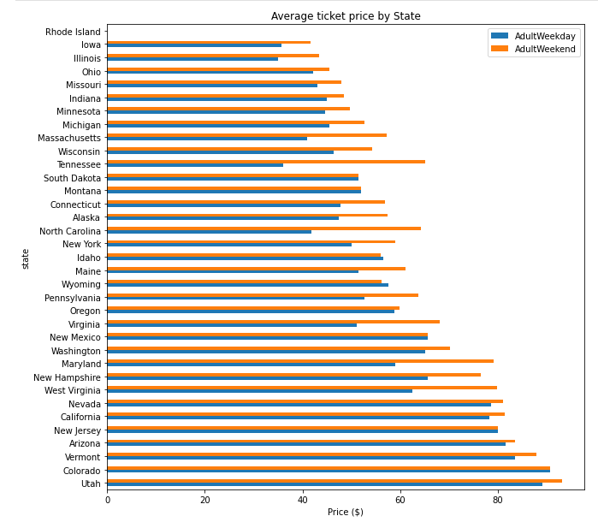
Average Ticket Price by State
Montana’s ticket prices average between $50-$60, while Utah, Colorado, and Vermont average prices are over $80.
Statistics from all states were useful in finding the weights of resort features to average ticket price.

Slide 6
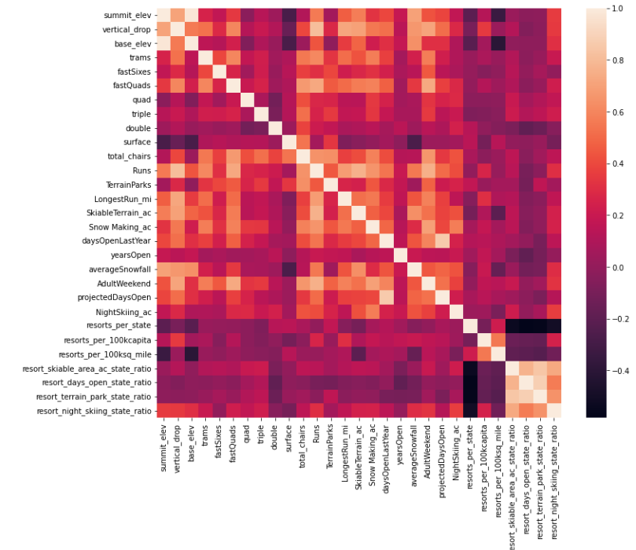
Correlation Between Features
Features weighted strongest for ticket price:
Fast quads
Runs
Snow making
Total chairs

Slide 7
What can be done as far as Modeling
Less variability in calculations than those of linear regression model.
Linear Regression Model
Random Forest Model
Random Forest Model was the standard model moving forward.

Slide 8
Calculations Using Random Forest Model
Top features of BMR affecting ticket value:
Vertical drop
Snow making
Total chairs
Fast quads
Runs
Longest run
Trams
Skiable terrain
Calculated ticket price,
given BMR features:
$95.87
Calculations were determined using data from all US resorts in the Random Forest Model.

Slide 9
Summary and Conclusion
$1.54 million increase in operating costs
Action Plan:
Identify key features
Calculate new value of ticket
Top features of BMR affecting ticket value:
Vertical drop
Snow making
Total chairs
Fast quads
Runs
Longest run
Trams
Skiable terrain
Recommendations:
Change ticket price to recommended $95.87.
Improve only features that increase ticket value the greatest.
Random Forest
Model
Recommended
ticket price:
$95.87

